Slide 1
DCLI
Chassis
Triage
THE DESIGN POSITION
The model
interprets language.
Rules and people
make accountable
decisions.
Operator console • LangGraph • Bedrock
Notes:
“This is a focused proof of concept for chassis damage triage. I approached it as a workflow-design exercise rather than a model-accuracy exercise.
The central design decision is simple: the model interprets ambiguous language, but deterministic rules and humans retain authority for safety, cost, and consequential decisions.
The system accepts a depot report, interprets the narrative, applies structured roadability and policy rules, either resolves it or pauses it for a human, and makes the entire path visible in an operator console.
I deliberately kept the scope narrow. The goal is to prove that the agent boundaries, orchestration state, human handoff, and AWS operating model are sound.”

Slide 2
THE DESIGN PROBLEM
A chassis report contains three different kinds of uncertainty
The workflow should use the least powerful mechanism that can resolve each kind safely.
INPUT TYPE
QUESTION
MECHANISM
WHY
Free-text ambiguity
What does the narrative mean?
LLM assessment
Language can be incomplete, conflicting, or contextual.
Published safety rules
Can it legally move?
Deterministic rules
The data dictionary gives explicit FMCSA/DOT criteria.
Business accountability
Should we accept risk or spend?
Policy + human review
This needs traceable thresholds and an override path.
DCLI CHASSIS TRIAGE • PROOF OF CONCEPT
02
Notes:
“I started by separating the kinds of uncertainty in the input because that determines the right mechanism.
The free-text narrative is genuinely ambiguous. A report may say the chassis feels loose, mention a collision, or contain conflicting observations. That is where an LLM adds value: it turns language into a structured assessment.
Roadability is different. The supplied data contains machine-checkable fields and explicit DOT/FMCSA out-of-service rules. I do not want a model deciding whether a brake percentage or tire tread depth is legal. That belongs in deterministic code.
Finally, disposition involves business accountability: repair spend, vendor capability, retirement economics, and risk acceptance. Those are named policy thresholds and, when needed, a human decision.
My principle is to use the least powerful mechanism that can safely solve the problem. That limits nondeterminism to the one place where it is useful.”

Slide 3
DECISION 1 — AGENT BOUNDARY
Only the Damage Assessor is agentic
It turns unstructured narrative into a validated Assessment; everything after that is structured policy.
CHOICE
WHY THIS CHOICE
WHAT I DELIBERATELY GAVE UP
01
Damage Assessor → LLM
It is the only component that reads and reconciles free text with structured data.
A broad “agent team” narrative; model scope is intentionally small.
02
Roadability → rules
OOS criteria are explicit in the supplied field dictionary and safety-critical.
Flexibility; the rule is transparent and testable instead.
03
Cost + Disposition → policy
They are calculations and business thresholds over known fields.
A model’s plausible but untraceable recommendation.
04
Supervisor → deterministic
Once Assessment exists, the next hop is a pure function of graph state.
An LLM router; I chose predictable, free, loop-free routing.
DCLI CHASSIS TRIAGE • PROOF OF CONCEPT
03
Notes:
“I made exactly one node agentic: the Damage Assessor.
It receives only the narrative evidence—damage description, incident context, and reporter confidence—and returns a validated Assessment. That Assessment includes severity, repair-scope hint, confidence, rationale, and narrative risk flags such as conflict or total-loss suspicion.
I intentionally did not use an LLM for Roadability. The supplied field dictionary explicitly defines the safety rules, so a deterministic implementation is safer, faster, cheaper, and unit-testable.
I also did not use an LLM for Cost, Disposition, or the Supervisor. Cost is a structured cost-book lookup. Disposition is a policy tree over roadability, cost, age, and repair capability. And after Assessment, routing is a pure function of graph state.
The trade-off is that this is less flashy than a broad ‘agent team.’ But it is far easier to audit and defend, especially for safety and spend decisions.”
ֿ

Slide 4
DECISION 2 — ORCHESTRATION
The supervisor re-enters after every specialist
ESTABLISH FACTS
INPUT
ROUTE
LLM
RE-ENTER
RULES
Report
Supervisor
Damage Assessor
Supervisor
Roadability
COMPLETE RECOMMENDATION
RE-ENTER
COST BOOK
RE-ENTER
POLICY TREE
RE-ENTER
Supervisor
Cost
Supervisor
Disposition
Supervisor
TERMINAL PATHS
NO REVIEW TRIGGER
TERMINAL
REVIEW TRIGGER
DURABLE INTERRUPT
AFTER DECISION
Supervisor
Resolve
Supervisor
Human Review
Resolve
Repeated Supervisor boxes represent the same LangGraph node re-entered after each completed specialist step. Human Review can branch after Roadability (early) or after Disposition (post-decision).
DCLI CHASSIS TRIAGE • PROOF OF CONCEPT
04
Notes:
“This is the actual execution model, read left to right.
The graph starts with a report. The Supervisor routes it to the Damage Assessor. Once the assessment is written to state, the Supervisor re-enters and routes to Roadability.
If there is no early review reason, the Supervisor then routes to Cost, re-enters again, routes to Disposition, and finally decides between Resolve or Human Review.
The repeated Supervisor boxes represent the same LangGraph node being re-entered after each specialist step. They are not separate supervisors and the specialists do not run in parallel.
There are two terminal patterns. If there is no review trigger, the Supervisor routes directly to Resolve. If there is uncertainty or a high-consequence decision, the Supervisor routes to Human Review, and the human decision then goes directly to Resolve.
This is why I used LangGraph rather than a hand-written loop. The graph gives me a checkpointed state machine, durable interrupts, and a framework-owned next transition.”
YǠ

Slide 5
DECISION 4 — HUMAN REVIEW
Human review is a durable graph interrupt
The point of pausing is different depending on whether the graph has enough information to recommend a disposition.
EARLY REVIEW: uncertainty is unresolved
POST-DECISION REVIEW: risk requires sign-off
#0013 — ABS conflict
#0004 — structural frame crack
Narrative says “looks fine”; telemetry says ABS fault. The graph pauses after Assessor + Roadability and skips Cost/Disposition.
Rules produce a retire recommendation and high cost. The graph pauses with a complete case for approval or override.
Why pause early?
Why pause after policy?
A person must reconcile conflicting evidence before policy creates false precision.
The policy can recommend; a human owns consequential spend and retirement decisions.
Resume is explicit: Command(resume=human_decision) records approve or override and then resolves.
DCLI CHASSIS TRIAGE • PROOF OF CONCEPT
06
Notes:
“Human review is a real LangGraph interrupt, not simply a status label.
There are two reasons a case may pause.
The first is early review, before a disposition exists. Report #0013 is the example: the gate note says no visible damage, but the telemetry feed indicates an ABS fault. The system does not pretend that this ambiguity can be resolved by applying more policy. It pauses after Assessment and Roadability, before Cost and Disposition.
The second is post-decision review. Report #0004 has a structural frame crack. Deterministic rules mark it out of service, the policy can recommend retirement, and the cost is consequential. The system produces a complete recommendation, but a human must approve or override it.
The review triggers are principled, not report-specific hacks: narrative conflict, advisory signals, low confidence, high cost, retirement recommendation, or suspected total loss.
When the human acts, the graph resumes with an explicit approve or override decision and then resolves the case. That decision is stored in state and logged.”

Slide 6
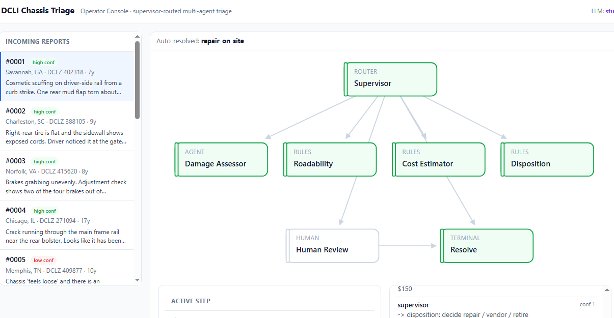
DECISION 5 — OPERATOR EXPERIENCE
The dashboard is an evidence surface, not a graph animation
Every visual element answers an operator question and comes from graph state or a node result.
01
What is active?
SSE step event updates the active node.
02
Why did it decide?
History exposes decision + rationale.
03
What evidence was used?
Tool calls and confidence travel with the result.
04
What happens next?
LangGraph planned transition, not a hardcoded display.
05
When must I act?
Interrupt state reveals review reasons and controls.
DCLI CHASSIS TRIAGE • PROOF OF CONCEPT
07
Notes:
“I built the dashboard as an evidence surface for an operator, not as a visualization for its own sake.
It answers five questions:
First, what is currently active? The SSE stream updates the active node as the graph executes.
Second, why did it decide that? Each step displays its rationale.
Third, what evidence was used? Tool calls and confidence are carried with the node result.
Fourth, what will happen next? The planned node comes from the graph’s actual state transition.
Finally, when must a human act? If the graph interrupts, the review reason and decision controls become visible.
I kept the frontend intentionally light: a static page, inline SVG, browser-native EventSource for SSE, and no React/Vite toolchain. The graph is fixed and small, so additional frontend infrastructure would add setup cost without improving the assessment criteria.”

Slide 7
DECISION 6 — EVALUATION AND INSTRUMENTATION
I measure whether the decision system behaves safely and predictably
Deterministic regression
15-report golden set asserts OOS, roadable/fit, terminal route, and all six human pauses.
Why: rule changes cannot silently break safety policy.
LLM contract check
Stub and Bedrock assessor must emit the same validated Assessment schema.
Why: the model is swappable without changing the graph.
Structured operations log
Per-node JSON: thread, decision, rationale, confidence, tools, elapsed time.
Why: a bad route can be investigated after the fact.
Production feedback loop
Review rate and override rate become drift signals; traces can flow to LangSmith/CloudWatch.
Why: humans reveal where policy or model interpretation needs work.
DCLI CHASSIS TRIAGE • PROOF OF CONCEPT
08
Notes:
“I do not evaluate this PoC primarily by whether the model gives a perfect answer. I evaluate whether the overall decision system behaves predictably and safely.
First, the deterministic behavior is tested against the 15 supplied reports. That includes roadability outcomes, policy paths, and the cases that must pause for a human.
Second, the Bedrock and stub implementations share the same validated Assessment contract. This means I can test the graph without AWS, then validate the live model at the boundary without changing the rest of the system.
Third, each graph node emits a structured JSON event with thread ID, decision, rationale, confidence, tool calls, and elapsed time. That gives operations a way to reconstruct a bad route.
Finally, the strongest production feedback signal is human behavior. If review or override rate rises, that tells us a policy rule or narrative interpretation needs investigation.
For live validation, Sonnet is the normal development model, and Opus is used only for final validation.”

Slide 8
DECISION 7 — AWS DEPLOYMENT
A clear AWS production path
Why Fargate?
AMAZON BEDROCK
The graph is an HTTP/SSE service; it needs no cluster operations.
Claude inference
S3 + CLOUDFRONT
ECS FARGATE
CLOUDWATCH / LANGSMITH
Static console
FastAPI + LangGraph
Traces + logs
DYNAMODB
Checkpoint state
Why DynamoDB?
A human pause must survive process restarts and scale-out.
IAM principle: use an ECS task role for Bedrock inference. Developer credentials never ship with the service.
DCLI CHASSIS TRIAGE • PROOF OF CONCEPT
09
Notes:
“This is a target deployment architecture, not infrastructure I claim to have provisioned for the take-home.
The browser receives the static dashboard through S3 and CloudFront. The API and LangGraph service run on ECS Fargate behind an Application Load Balancer because this is an HTTP and SSE workload; Fargate avoids unnecessary cluster management.
The service invokes Claude through Amazon Bedrock. It stores durable graph checkpoints in DynamoDB because a human review may last hours or days and must survive container restart or scale-out.
Structured logs go to CloudWatch, while model and graph traces can go to LangSmith or an OpenTelemetry-compatible observability system.
The key security decision is that production uses an ECS task role. Developer SSO credentials and local .aws files never ship with the service. The task role receives only the approved Bedrock Mantle inference permission.
I did not deploy Fargate, DynamoDB, CloudFront, or LangSmith for this one-day PoC because that would not better demonstrate the rubric. The architecture explains where each concern belongs.”

Slide 9
WALKTHROUGH EVIDENCE
Three reports make the trade-offs tangible
#0001
#0013
#0004
Cosmetic scuff + torn mud flap
“Looks fine” vs ABS telemetry fault
Structural frame crack
Auto-resolve: repair on site
Early human review
Post-decision human review
Why: no OOS rule, low cost, high confidence.
Why: advisory conflict is not an OOS conclusion; do not invent certainty.
Why: deterministic OOS + high cost/retire recommendation require accountable sign-off.
Recommended demo order: #0001 proves the happy path; #0013 proves the system knows when it does not know; #0004 proves policy does not bypass human accountability.
DCLI CHASSIS TRIAGE • PROOF OF CONCEPT
10
Notes:
This is the walkthrough sequence. Do not lead with the dashboard. Lead with #0001 to establish the normal path, then #0013 to defend uncertainty handling, then #0004 to defend high-consequence approval.

Slide 10
CONCLUSION
Policy and people retain authority
The model produces a structured interpretation; that boundary makes this a defensible triage system.
Why one agent?
Why human review?
Only free-text interpretation needs language judgment.
Ambiguous and consequential cases should not auto-resolve.
Why LangGraph?
Why this AWS shape?
State, interrupts, and real planned transitions are first-class.
Inference, execution, state, and observability scale independently.
Result: a scoped proof-of-concept that is easy to reason about, test, demo, and evolve.
DCLI Chassis Triage • Proof of Concept
11
Notes:
Close with the consequence of the choices. Do not describe this as production-ready: describe it as an auditable, focused architecture with a credible production path.

